Slide 1

Ysgol Bodfari
'Learning from each other, succeeding together'
Curriculum Rationale

Slide 2
Vision
At Ysgol Bodfari we aim to provide a safe and supportive environment that enables all learners to become confident, resilient individuals.
We aim to provide engaging and authentic experiences which allow children to explore and investigate the world around them.
We aim to ensure that all learners succeed and achieve at their own pace

Slide 3
Our Curriculum
Everything a student learns in school is part of the school curriculum. The needs of all our learners are at the forefront of our minds while constructing and developing the curriculum at Ysgol Bodfari.
We consider “What, Why and How we teach” in great detail.

Slide 4
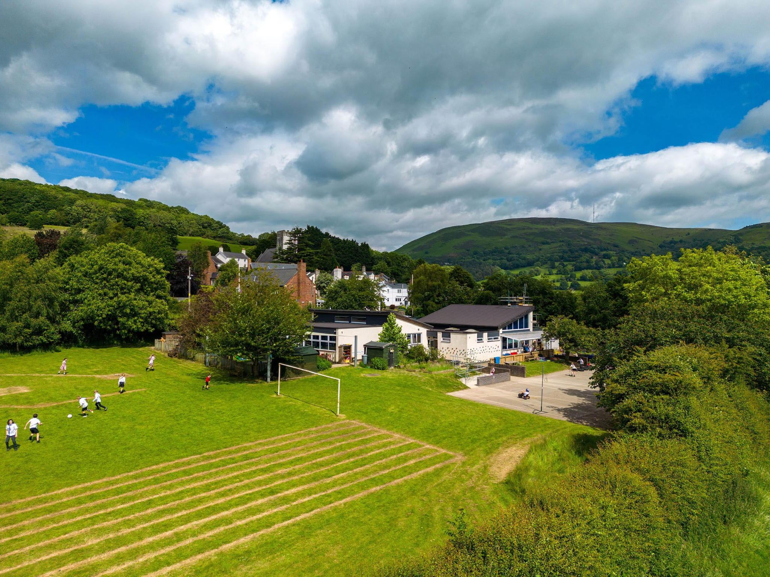
Unique Factors
Location
Ysgol Bodfari is situated in a rural community consisting of our school, the Dinorben Arms, St Stephen’s church, AP Motors and the Oriel Gallery. The school itself is based in the centre of the community and boasts beautiful grounds which provides a perfect learning environment for our students.
This allows pupils to:
• Explore the outdoors while learning and in their own time.
• Build links with a small community giving them a sense of belonging.
• Link with local businesses to develop skills and understanding of the wider world.

Slide 5
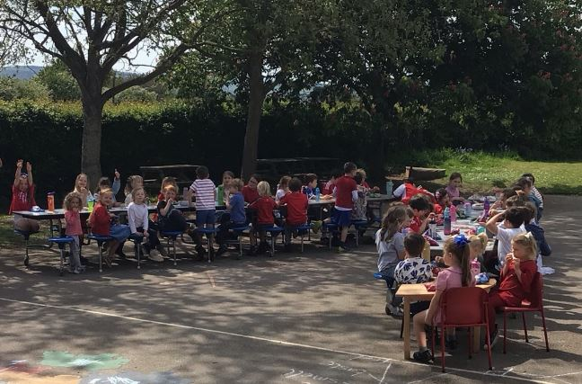
Small school ethos
“Coming to school is like having a second family”. Evelyn H, Year 6.
Our school consists of a Foundation Phase class that supports learners from Nursery to Year Two and a Key Stage Two class that educates pupils in Years Three to Six. We have a small team of highly skilled staff with transferable skills. The size of our learning environment means that we get to know each individual pupil, their strengths and personalities.
This allows pupils to:
• Build relationships based on trust and respect.
• Feel that they are heard and supported.
• Develop positive relationships with peers.
“We might be small, but we are strong” Fern J, Year 5.

Slide 6
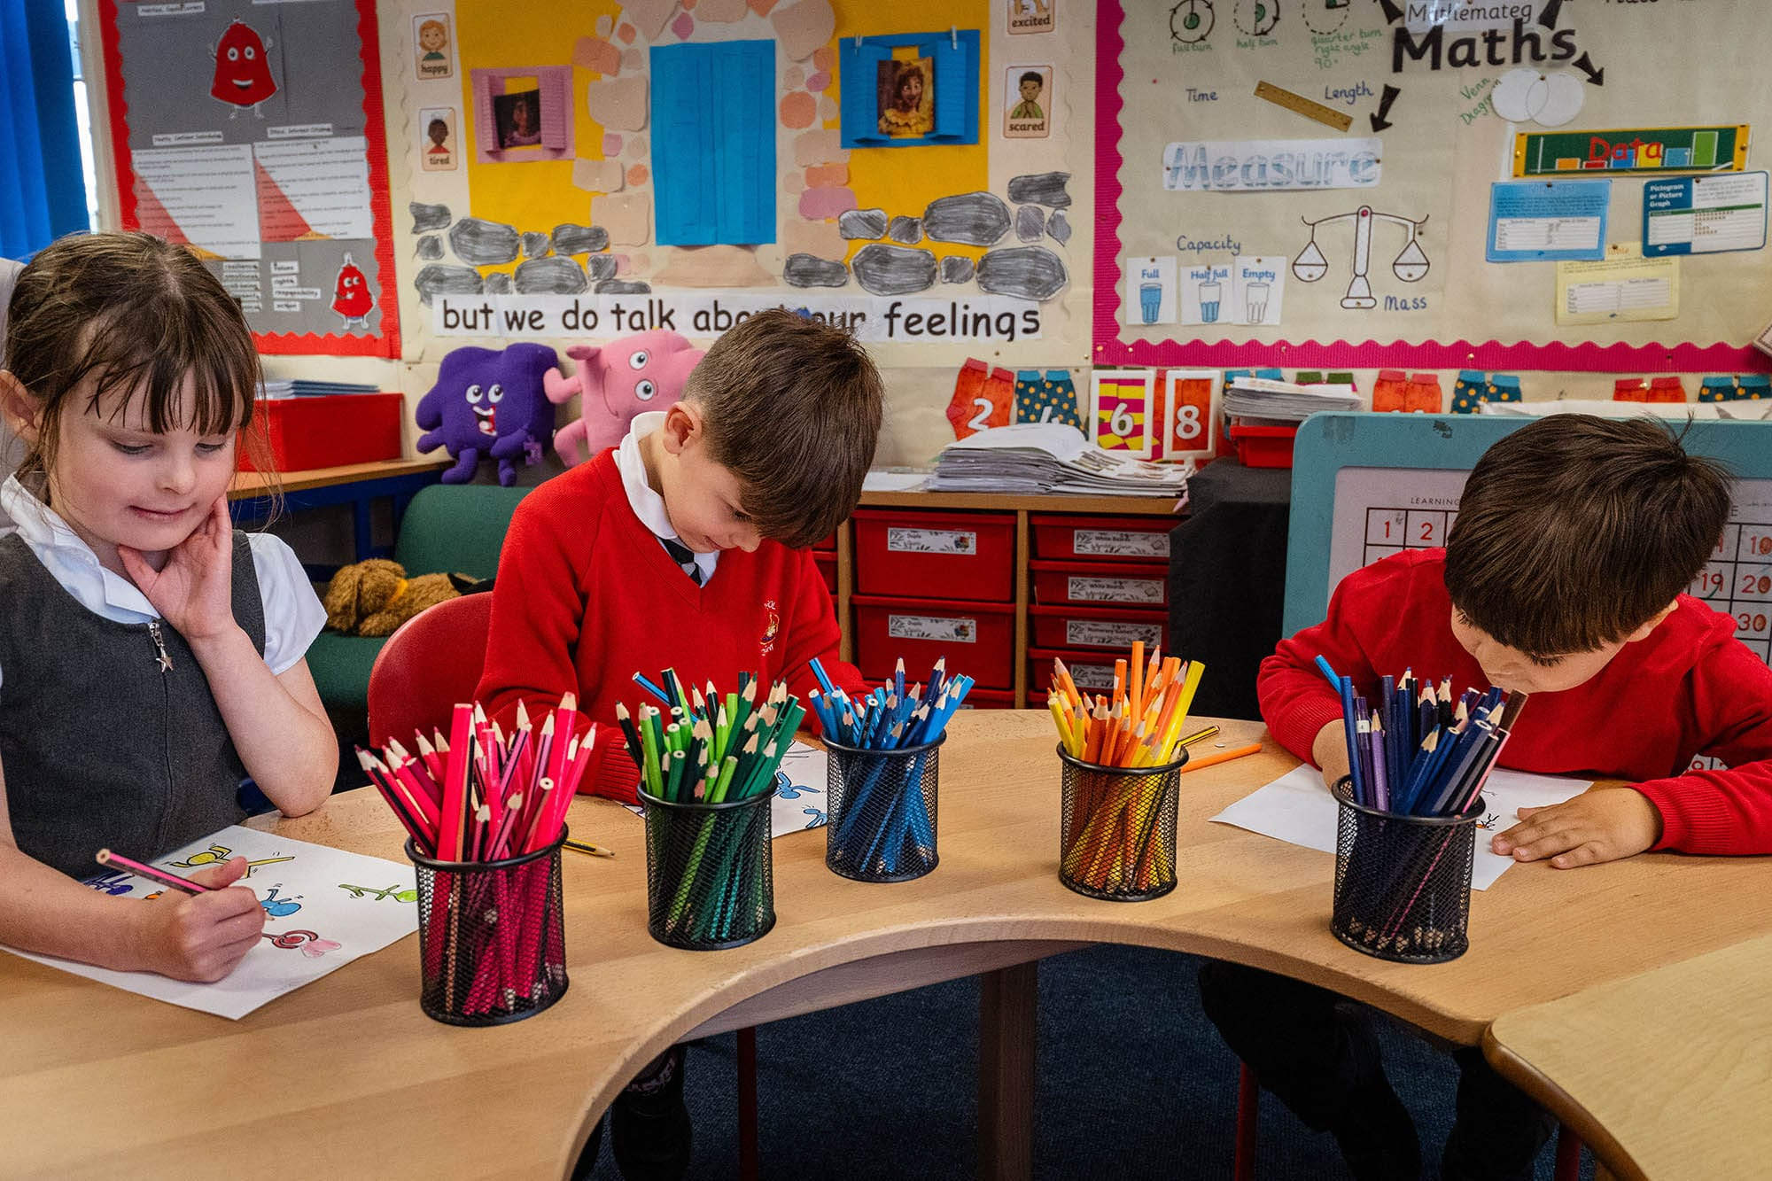
Learning
Pupils are fully involved in the development of an engaging curriculum that encompasses their interests and questions. Pupils voice is paramount in all areas of school life.
“We get to learn about topics we enjoy.” Seb B, Year 5.
This allows pupils to;
• Feel valued and take ownership of their learning.
• Be engaged in their own learning as it has been led by them.
• Progress in their learning and show improvement at their own pace.
“ This school is great because everyone shines doing their work” Willow R, Year 2

Slide 7
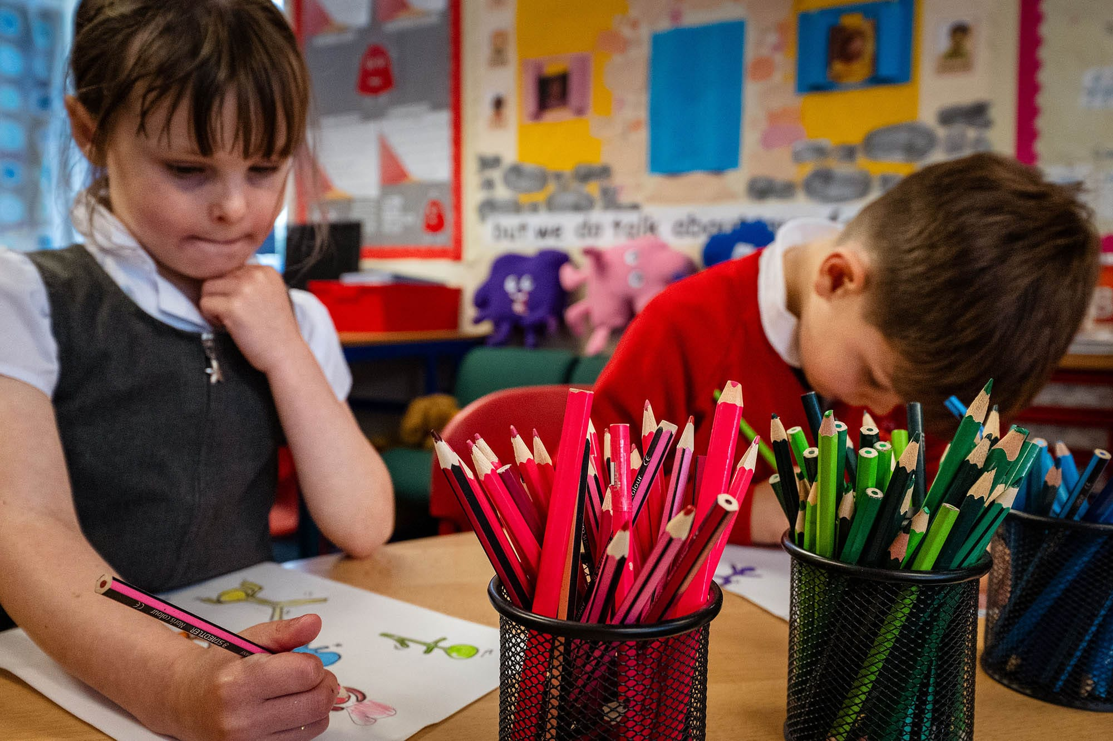
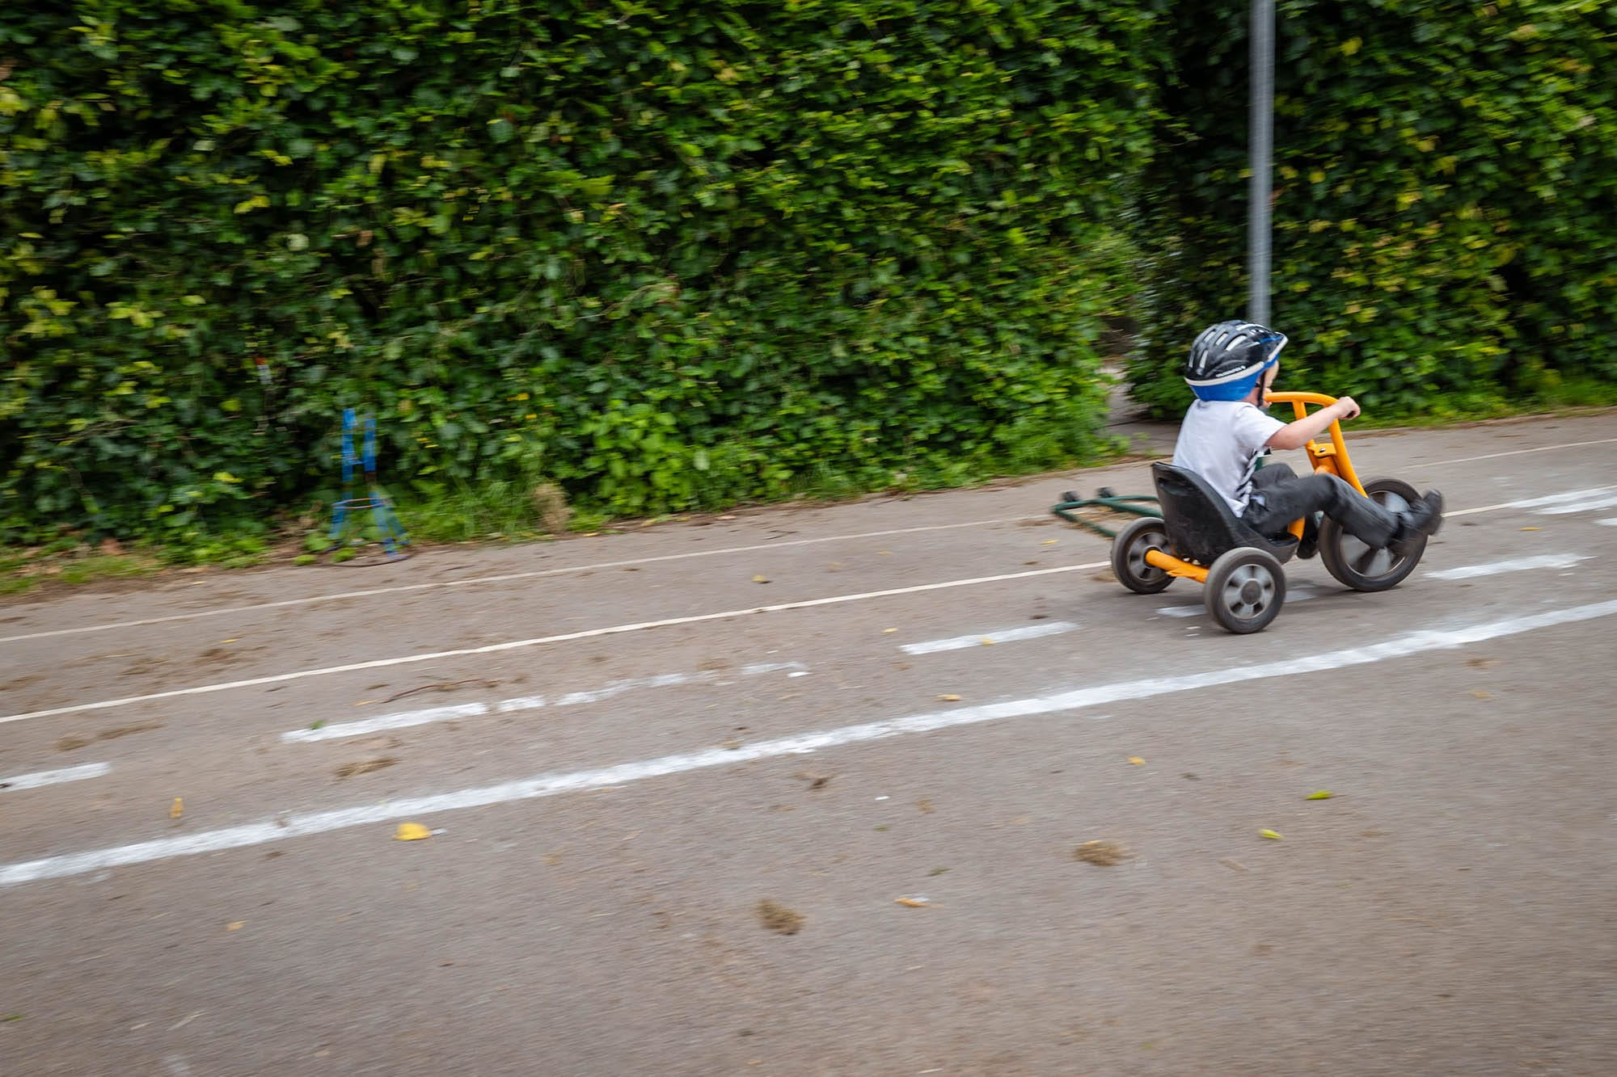
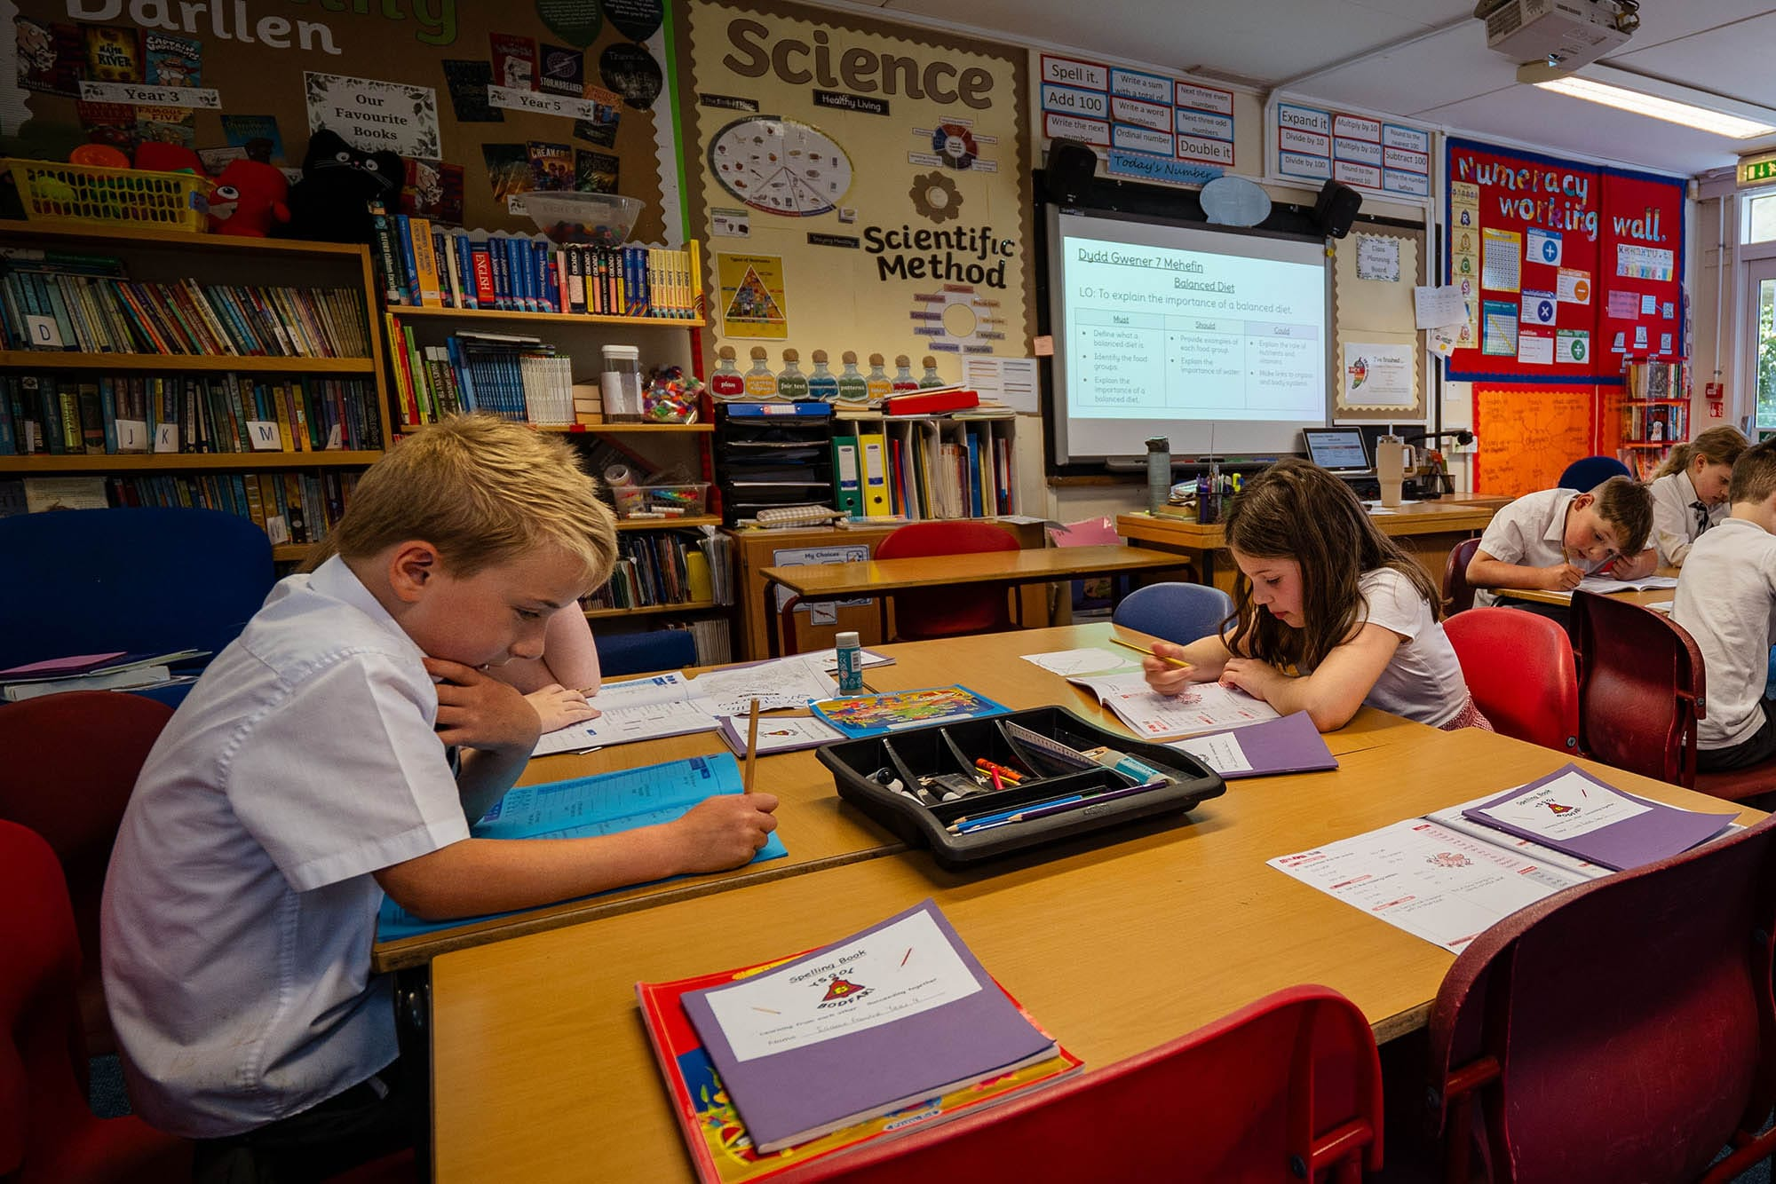

Slide 8

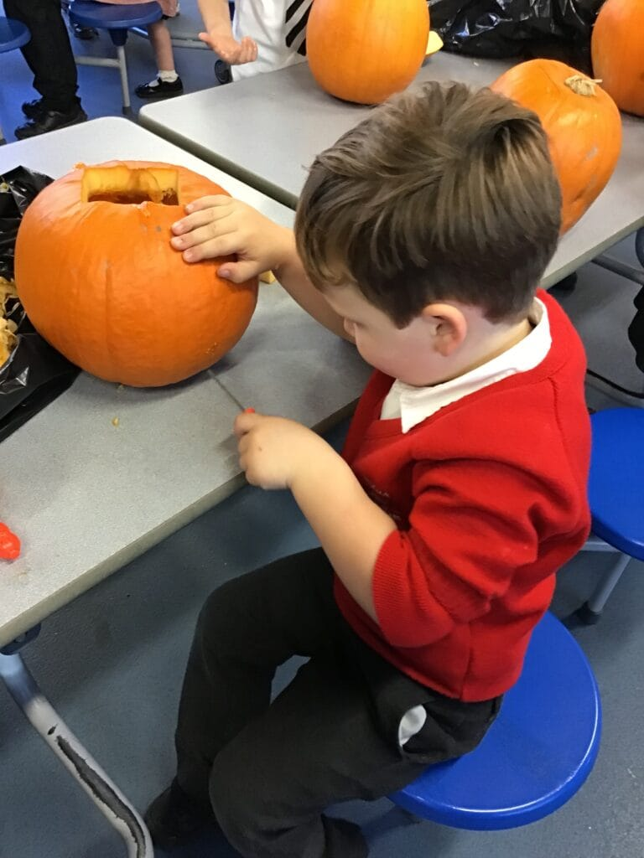
Wrap around care
Ysgol Bodfari hosts Busy Bods Wrap Around care which starts with a breakfast club from 7:45am. Busy Bods Playgroup welcomes children ages 2years 3months to join a fun and immersive learning environment ready for the start of their school journey. In addition, Busy Bods run an after-school club which cares for all school children until 5:30pm Monday to Friday.
This allows pupils to;
• Start the day with a healthy breakfast, while providing childcare for working families.
• Our youngest learners in playgroup build relationships with school staff and start their learning journey in a high performing playgroup setting.

Slide 9
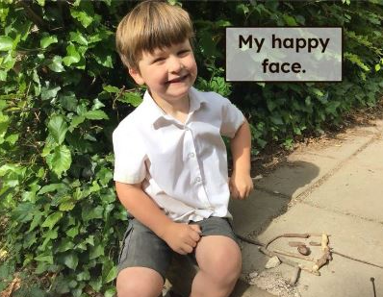
Wellbeing and support
All classroom staff are highly trained in supporting the wellbeing and development of our children. We understand children are individuals and we are able to support them irrespective of their needs or backgrounds. Each child is valued and we pride ourselves on the understanding that every child in our school matters. We encourage children to show care and empathy towards each other.
“The teachers help us have fun!” Alex D, Year 5.
This allows pupils to;
• Feel they can share their emotions and experiences with staff.
• Approach staff in times of need.
• Be ethically informed citizens within our school and the wider world.
“Our teachers are special and kind.” - Skye M, Year 6.

Slide 10
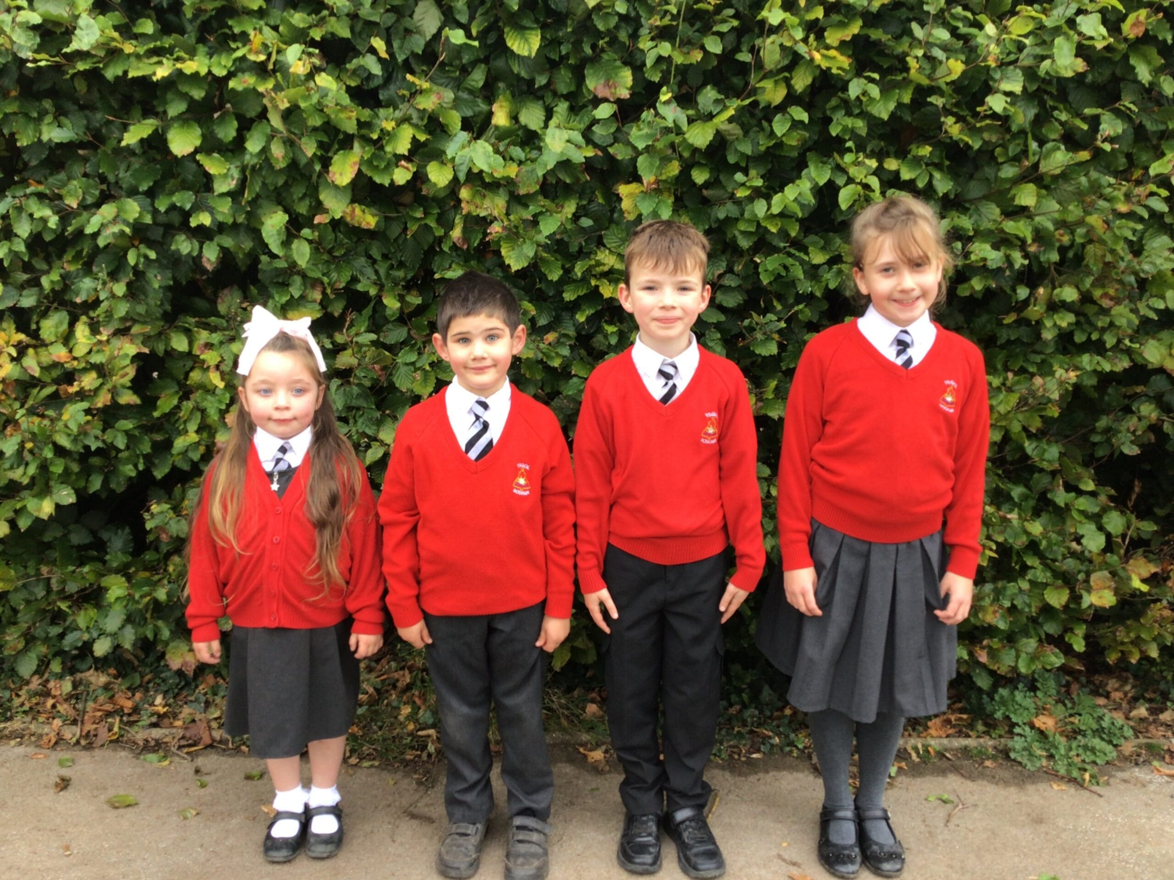
Values and Ethos
At Ysgol Bodfari we believe that;
• All children have a sense of belonging in our school, community and the wider world.
• All children feel safe and supported in a warm and welcoming environment.
• We understand and value the whole child including their strengths, talents and personalities.
• We are inclusive to all.
• Every child has the right to learn and develop at their own pace.
• We lay the foundation of lifelong learning.

Slide 11
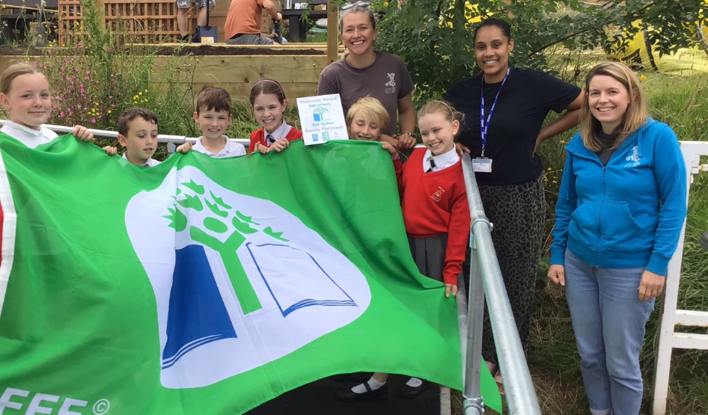
Behaviours
What stakeholders like about us:
Parents:
My child comes home every day with something new to tell me that they have learnt.
All topics have had activities to engage them.
Wonderful school with the best staff.
The school are very supportive and understanding.
I cannot rate this school anymore than I do!
Members of the community:
The children were excellent!
Pupils listen and follow instructions so well.
The children are doing an amazing job with the garden, they should be very proud of what they have achieved.
Feedback 2024

Slide 12

What Estyn said about us …
We were visited by an Estyn Inspection team in November 2024. We are very proud to say that they found...
Standards of behaviour are excellent.
Staff establish positive nurturing relationships with pupils.
Staff, including support staff, are highly skilled in questioning.
Pupils have regular opportunities to use their Welsh language. In addition, they learn about their Welsh heritage and culture.
The work to improve reading exemplifies leaders' capacity to bring about change through strategic planning.
Teachers draw on local expertise to enhance pupils' learning.
There are many valuable opportunities for pupils to take on leadership roles that influence the life and work of the school.
Parents hold the school's work in high regards and are very pleased with the school's role in nurturing and educating their children.
Pupils enjoy school and their rates of attendance are good.
In addition, we were 'spotlighted'. This is a new part of the inspection process where inspectors identify interesting or innovative practice in a setting. Our 'spotlight' stated:
'Using assessment to support learning, especially of pupils' literacy and numeracy skills which is highly effective. Personalised next steps and to support children of all abilities to make progress in the development and application of literacy and numeracy skills.'

Slide 13

Curriculum Considerations
To allow us to create a comprehensive and balanced curriculum that is relevant to our learners, we shall explore all of the fundamental components of the Curriculum for Wales framework.

Slide 14
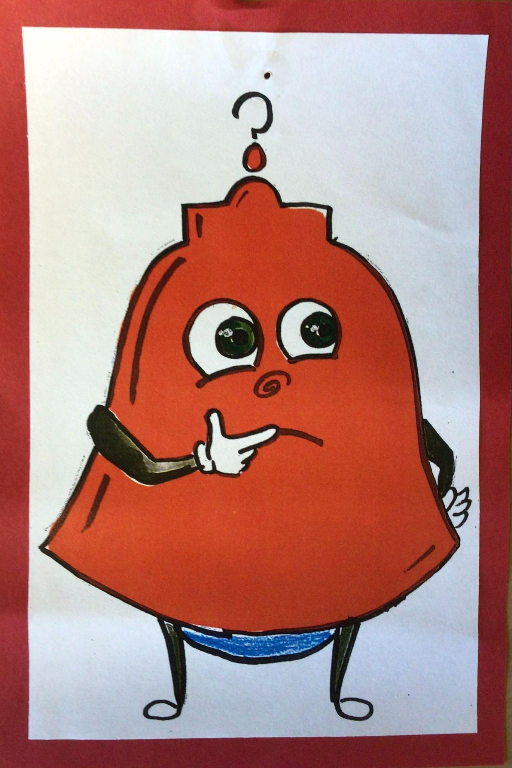
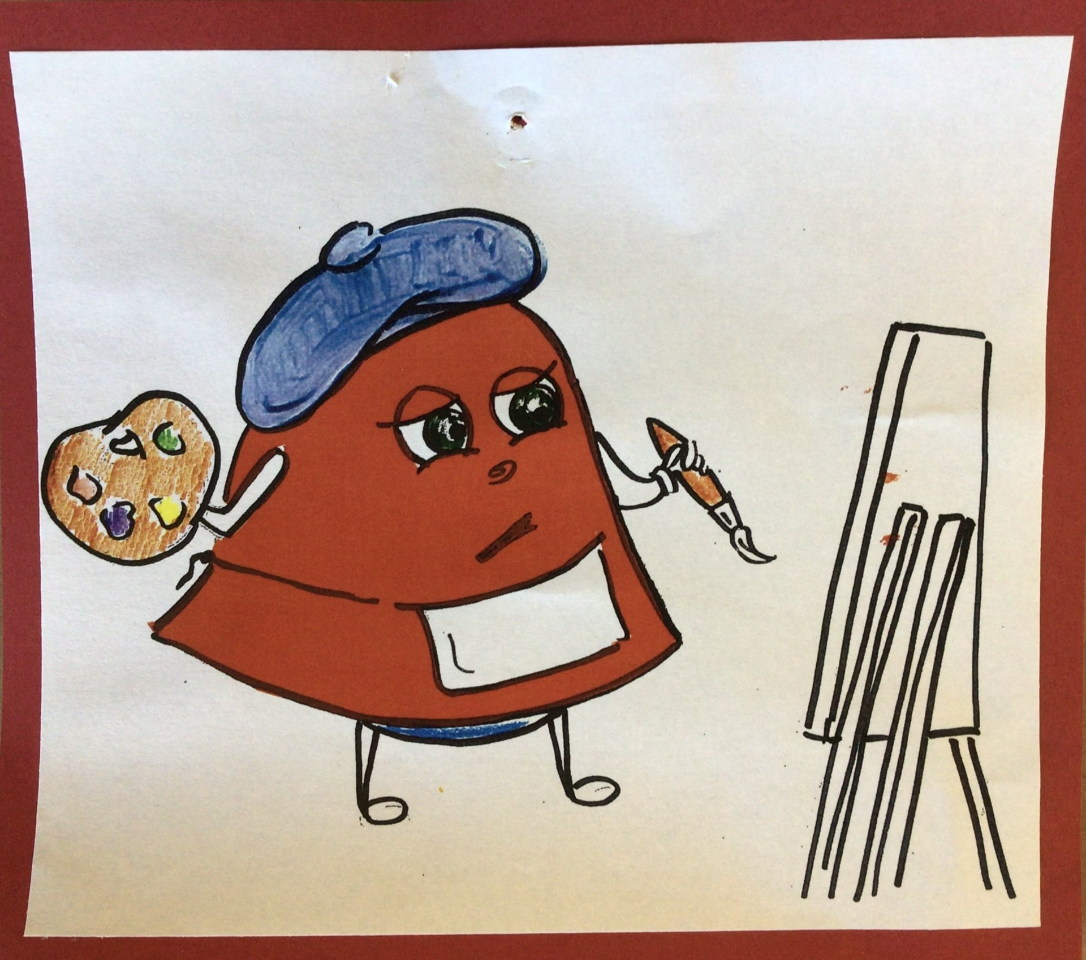
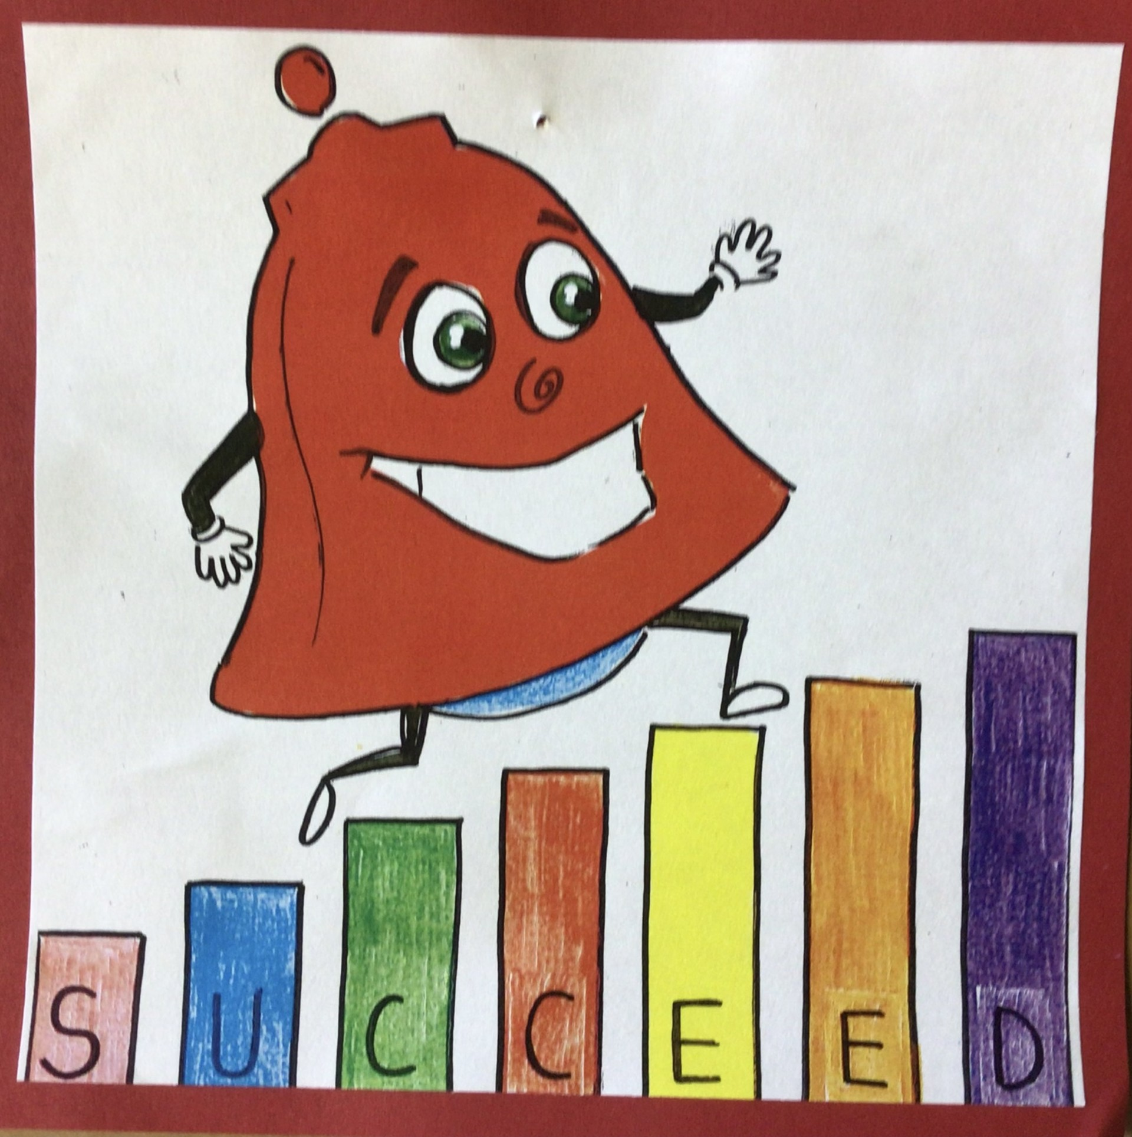
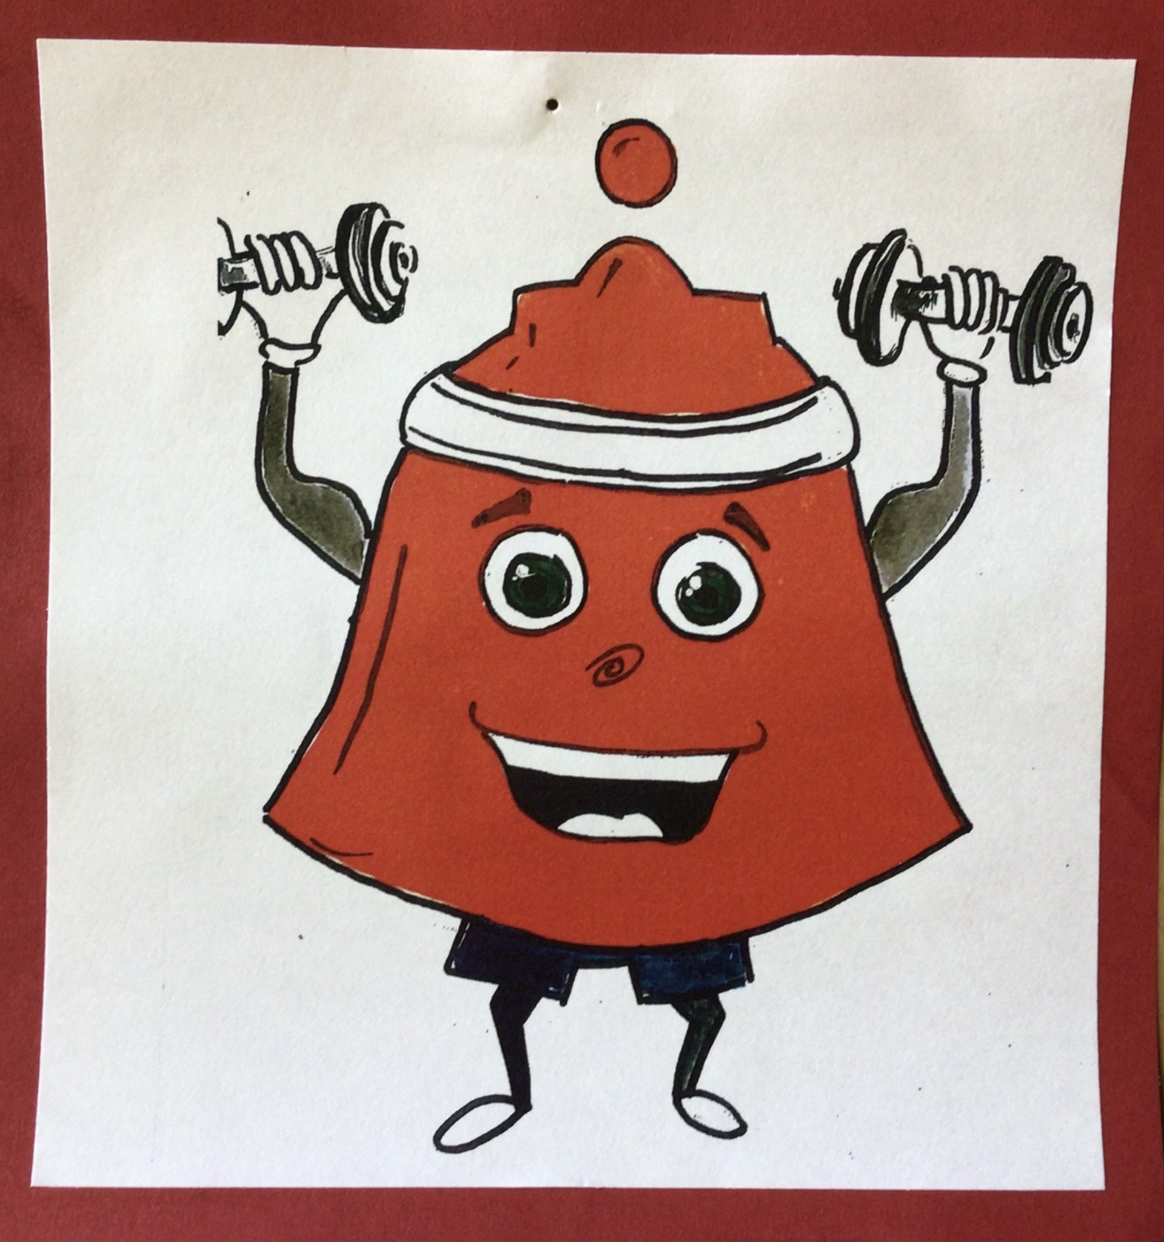
Overview of Curriculum for Wales
Four Core Purposes
The four purposes are the guiding aspiration for our school curriculum. We want our learners to become;
• ambitious, capable learners, ready to learn throughout their lives
• enterprising, creative contributors, ready to play a full part in life and work
• ethical, informed citizens of Wales and the world
• healthy, confident individuals, ready to lead fulfilling lives as valued members of society

Slide 15
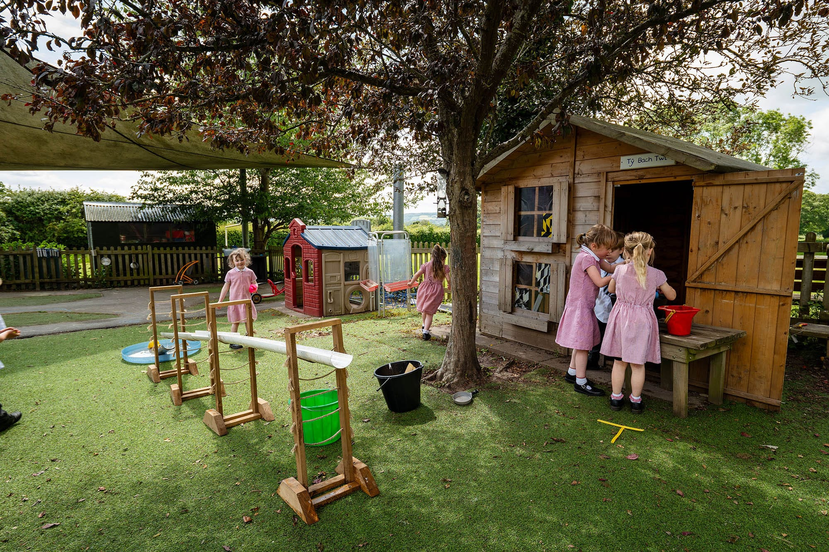
Integral Skills
The four purposes are also underpinned by integral skills which will be developed within a wide range of learning and teaching. At the heart of these skills is the importance of our learners recognising, using and creating within a range of contexts that include financial, cultural, and social situations.
• Creativity and innovation
• Critical thinking and problem-solving
• Personal effectiveness
• Planning and organising

Slide 16
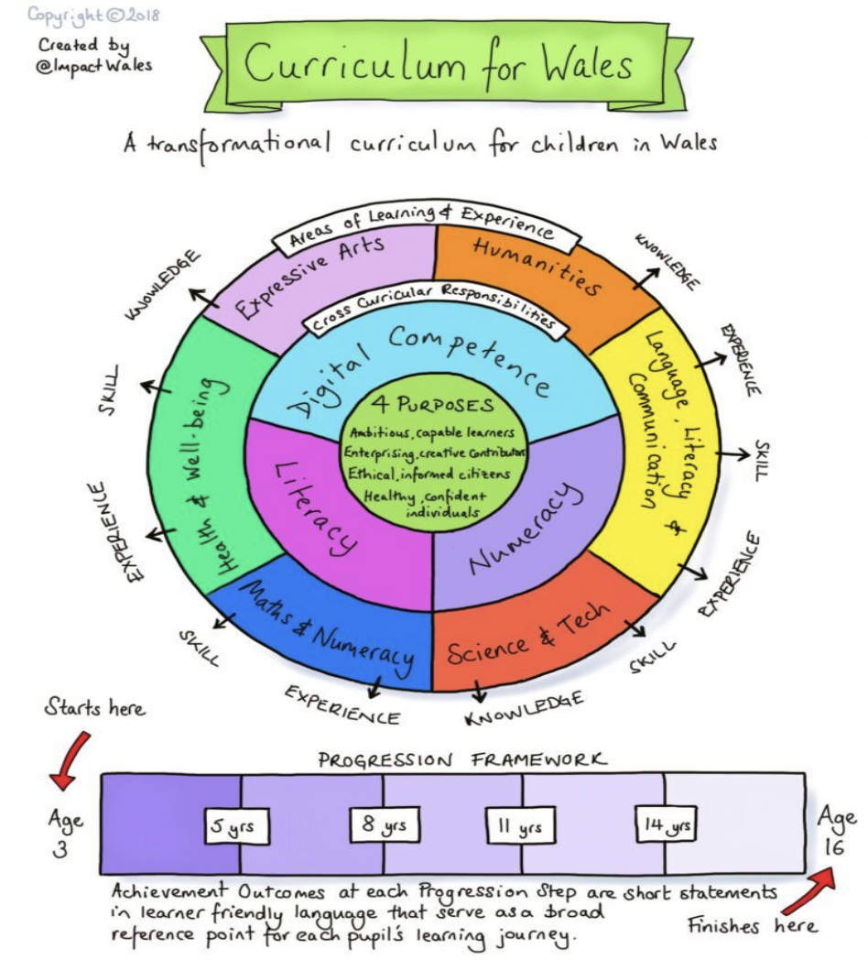
Cross – Curricular Skills
All learning and the ability to unlock knowledge requires the mandatory cross-curricular abilities of literacy, numeracy, and digital competence. They enable our students to:
• improve their listening, reading, speaking, and writing skills;
• be able to utilise numbers and solve problems in real-life situations; and
• be confident users of a variety of technologies to help them function, communicate, and make sense of the world.

Slide 17
Five Cross Cutting Themes
There will be opportunities for learning and consideration of cross-cutting components incorporated into our school curriculum.
This will allow our learners to;
• consider local, national and international contexts
• develop understanding of careers and work-related experiences
• develop understanding of human rights education
• understand the meaning of diversity

Slide 18
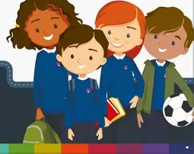
Relationships and Sexuality Education (RSE)
Relationships and Sexuality Education (RSE) is a mandatory element of the new curriculum and will be included through the cross-cutting elements of the curriculum, focusing on the three strands: • Relationships and identity • Sexual health and well-being • Empowerment, safety and respect
RSE is a mandatory part of the curriculum and will be taught to pupils between the ages of 3 to 11 years.

Slide 19
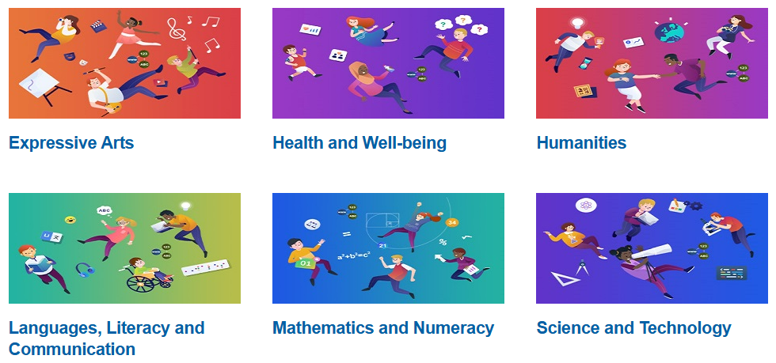
Areas of Learning Experience
Opportunities for learning will be channelled through the following Areas of Learning:
• Expressive Arts
• Humanities
• Languages, Literacy & Communication
• Mathematics & Numeracy
• Science & Technology
• Health & Well-Being

Slide 20
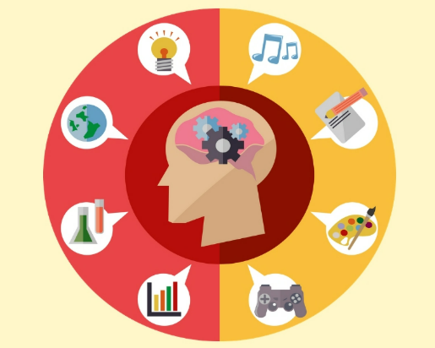
Topic based approach to learning
In both the Foundation Learning and Key Stage Two classes we teach through child initiated topics where all areas of the curriculum come together to create one holistic approach to learning. This allows our children to consolidate the skills they have learnt in meaningful and real life contexts.
There are some examples where skills such as phonics and guided reading are taught in isolation to the topics due to their nature. However, when purposeful links can be made, these will also link to the main class topic

Slide 21

Religion, Values and Ethics at Ysgol Bodfari
Religion, Values and Ethics is a mandatory part of our Humanities curriculum and is built upon a series of concepts and big ideas. Our curriculum provides a range of disciplinary approaches to support learners to engage critically with a broad range of religious and non-religious philosophical convictions.
RVE forms part of the Humanities Area. This Area encompasses geography, history and religion, values and ethics. These disciplines share many common themes, concepts and transferable skills, whilst having their own discrete body of knowledge and skills.
There is no parental right to request that a child is withdrawn from RVE in the Curriculum for Wales.

Slide 22
In Ysgol Bodfari we have a regard to the Denbighshire Agreed Syllabus which is based on the Religion Values and Ethics Guidance. When designing our curriculum for Religion, Values and Ethics we consider:
• cross-cutting themes
• cross-curricular skills
• skills integral to the four purposes
• Religion, Values and Ethics and the statements of what matters
• Spiritual development
• Religion, Values and Ethics Concepts
• The Religion, Values and Ethics lens
Religion, Values and Ethics supports the General Curriculum requirements that The curriculum is a balanced and broadly based curriculum that⁠:
• promotes the spiritual, moral, cultural, mental and physical development of the pupils and of society, and
• prepares the pupils for the opportunities, responsibilities and experiences of later life.
It promotes healthy, confident individuals who have secure values and are establishing their spiritual and ethical beliefs
In Ysgol Bodfari Religion, Values and Ethics may be taught as part of a topic or as discrete lessons.

Slide 23

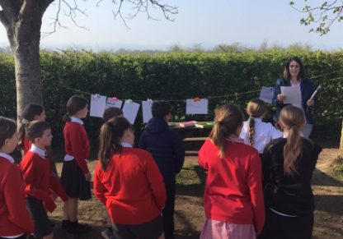
Cynefin
Children learn about their own localities and elsewhere in Wales, as well as in the wider world, which can help learners discover their heritage and develop a sense of place and cynefin.
It can also promote an understanding of how the people of Wales, its communities, history, culture, landscape, resources and industries, interrelate with the rest of the world.

Slide 24
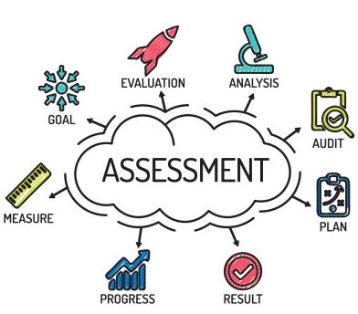
Assessment
Teachers will collaborate with students to identify their strengths, areas for improvement, and next stages in learning as assessment is an essential component of the learning process.
Any assessment's main goal should be to aid each learner in moving forward. The following three aspects of assessment will help our learners continue to progress in their learning;
• Providing ongoing, daily assistance to individual students
• Tracking, recording, and reflecting on each learner's development over time
• Recognising group development to reflect on practice within their learning
Tools that will support our assessment processes include:
• AfL (Assessment for Learning) approaches within the classroom
• Monitoring cycles that include 'Learning Walks', 'Listening to Learners' and 'Book Monitoring'
• Online Scheduled Assessments
• Internal assessment activities
• Pupil Progress Meetings
• Growth Mindset
• PASS

Slide 25
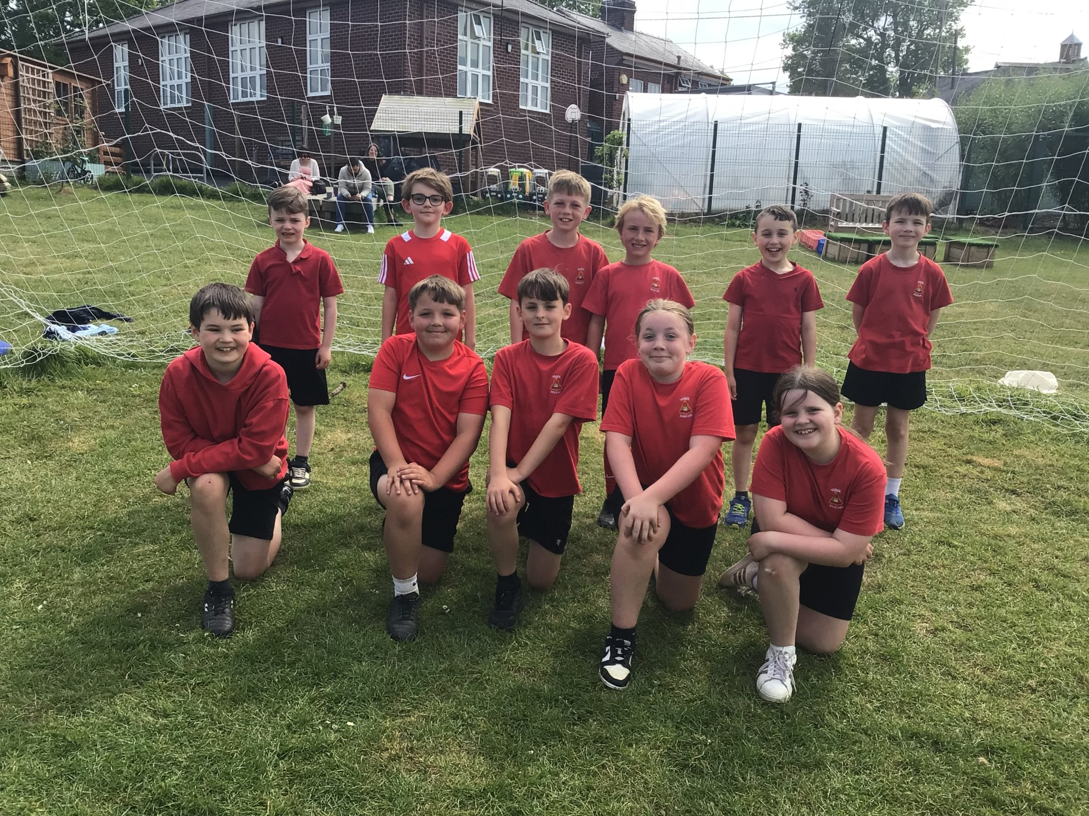
Enrichment
Enrichment activities as those which are provided to enhance the learning experiences of our pupils. Curriculum for Wales shines a light on these experiences for our learners to have opportunities that they may not have been familiar with otherwise.
We aim to provide a range of enrichment activities for our learners of all ages. These include;
• Trips
• Visits to school from experts to share their knowledge
• In school celebrations
• Film Nights
• Sporting Events
• Working with Secondary Schools
• Denbighshire County Council activities

Slide 26

Equal Opportunity
Our school is aware of the needs and circumstances of all our learners. Our school curriculum considers equal opportunities through putting into place sufficient challenge, support and interventions or making reasonable adjustments as required.
Our curriculum is designed to be inclusive of all learners - including those with Additional Learning Needs (ALN), More Able and Talented learners (MAT), pupils with English as an Additional Language (EAL) - allowing learners to progress along the same continuum of learning. Although, the pace at which learners progress along the continuum may differ – this provides opportunities to repeat, reflect, challenge and support as required for our learners on a group or individual basis.

Slide 27

Reflection and Evaluation
Both children and teaching staff are always reflecting and evaluating teaching and learning approaches.
Children reflect on the things that they have made or done and consider how they may progress.
Teaching staff evaluate topics at the end of each half term, considering what has worked and what they would do differently next time. They also continuously reflect on their pedagogy and teaching skills, seeking appropriate professional development (CPD).

